Slide 1

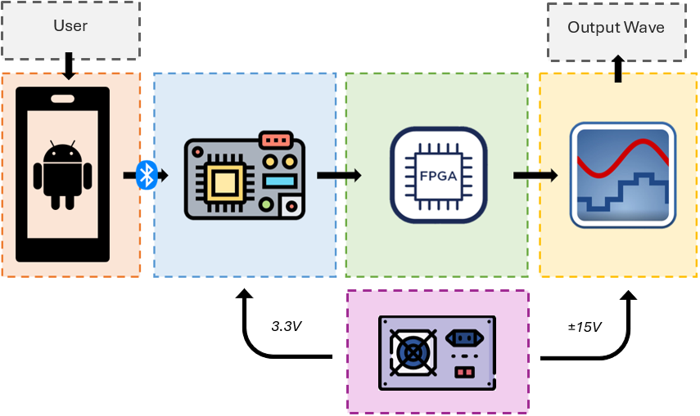
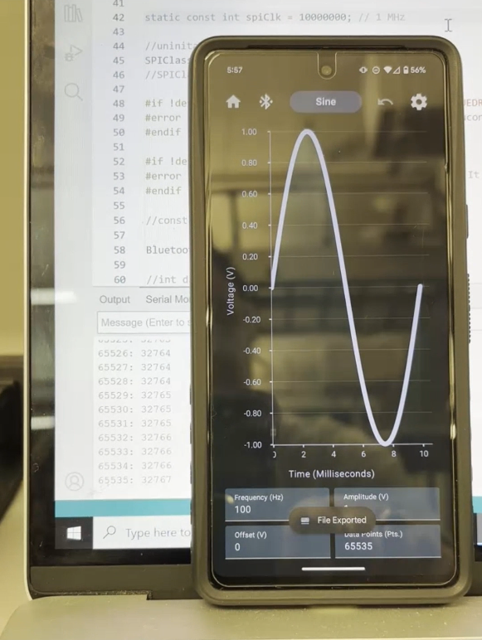
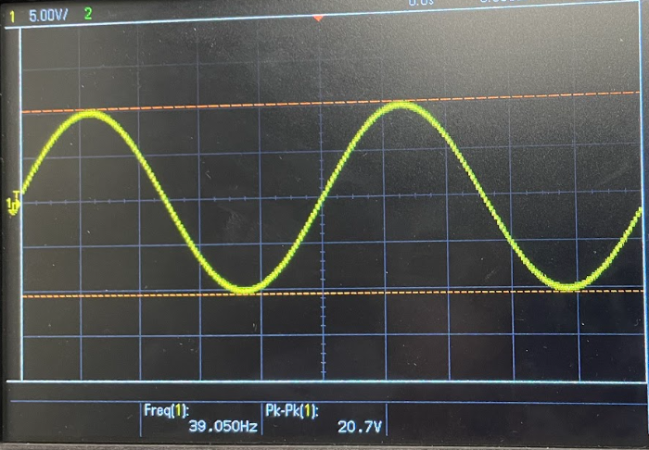
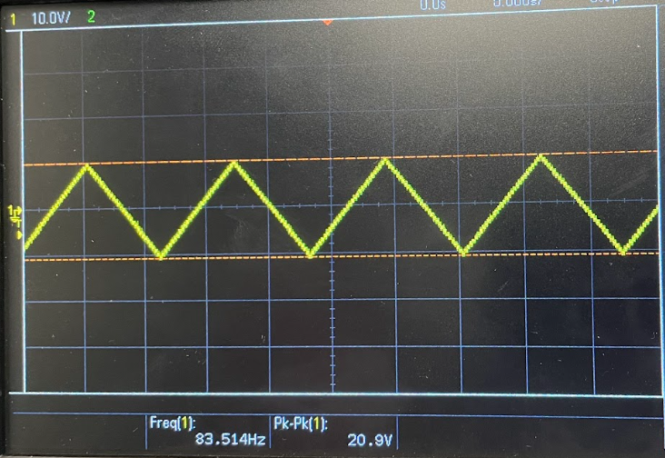
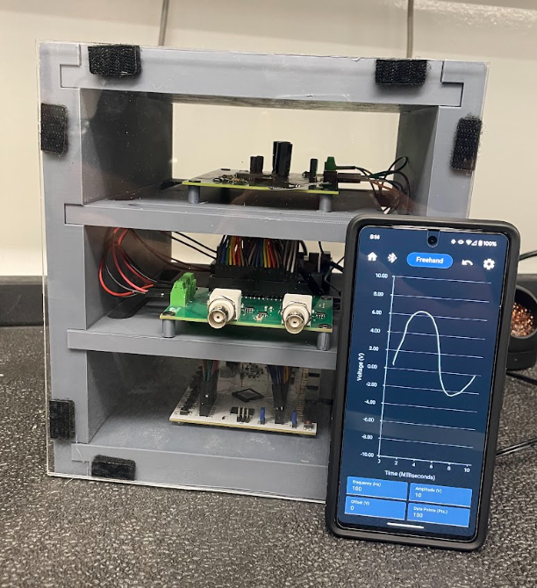
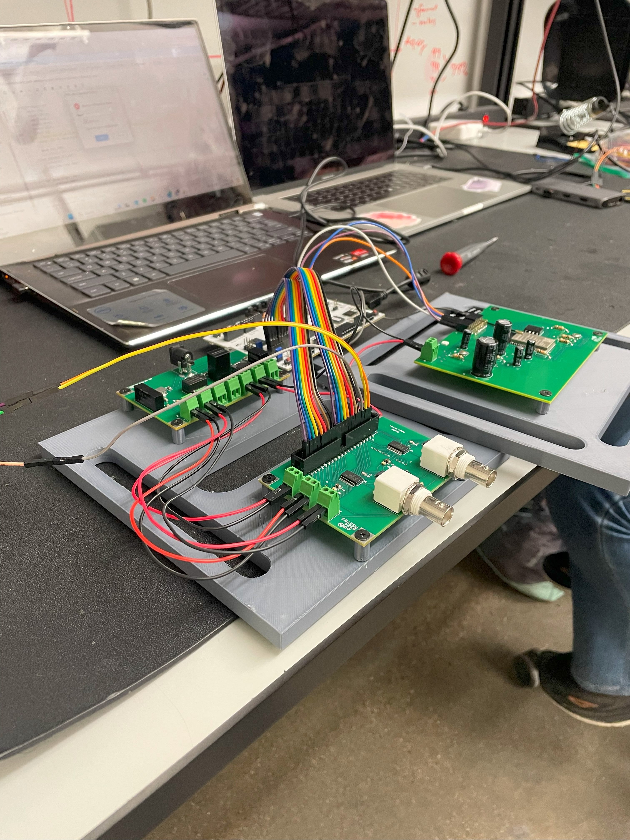
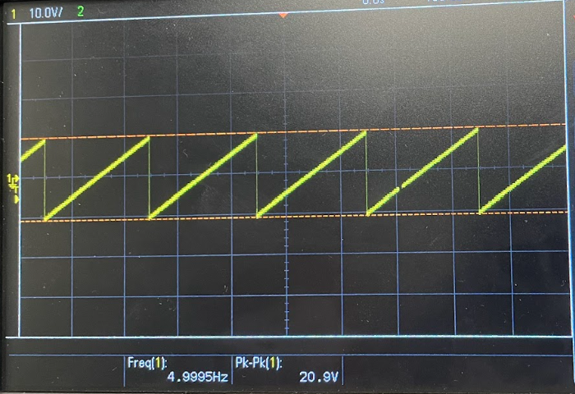
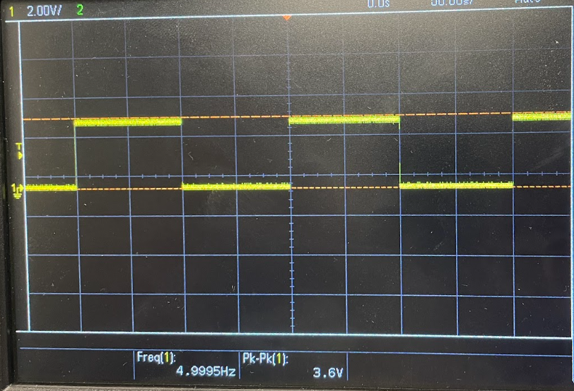
EPS Booth: 306
Arbitrary Waveform Generator App
Leandro Bracho, Nick Joseph, Oscar Medrano, Robin Smithson
Dr. John Lusher II
Problem Definition
Test validation is a vital step in the design and fabrication of circuit boards for any project in the realm of electrical engineering. Our team was tasked with creating an Arbitrary Waveform Generator that interfaces with a user’s phone for ease of a more intuitive test validation method.
Engineering Analysis
Our project incorporated a range of software and hardware topics covered within Electrical Engineering such as programming in multiple languages, designing and soldering PCBs, and circuit design and validation.
For software, the languages Kotlin, C, and Verilog were used to pass user defined data to the DAC to output a continuous voltage wave. [Figure 2]
For hardware, all PCBs were designed within Altium and tested with multimeters to ensure the board was soldered correctly. To validate the boards functionality test case values were used as inputs to ensure the system outputted correctly. [Figures 3-4]
Functional Block Diagram
Table 1. Project Specifications
Dimensions
 | Length (mm) | Width (mm) | Height (mm)
Housing | 210 | 190 | 230
Shelves | 190 | 190 | 10
Connection Type
 | Max Range (ft) |  | Max Range (ft)
Bluetooth | 25 | BNC | 3
Methodology
Our project was broken up into 5 subsystems: Android app, microcontroller, FPGA, DAC, and power system.
Android App
Developed an Android App using Kotlin to generate 5 different waveforms
Transmits data with Bluetooth Classic to the MCU
Microcontroller
Receives data from the app via Bluetooth Classic
Implemented SPI protocol to transfer data to the FPGA
FPGA
Receive and store data from MCU into SRAM
Continuously pass data from SRAM to the DAC
DAC
Designed a bipolar output circuit capable of generating waveforms within a ±10V range.
Dual-channel capability
Power System
Developed a system of power converters to produce +15V, -15V, +5V, +3.3V, and +1.2V to power all the subsystems.
Impact
By controlling the arbitrary waveform generator through an app, it can offer enhanced functionality, usability, and flexibility for a variety of applications in engineering research, and education.
Ease of Use: The app provides an intuitive interface for waveform selection and adjustment. This reduces the learning curve for users and streamlines the process of generating specific waves.
Customization: The ability to draw freehand waveforms expands the possibilities for waveform generation, allowing users to create custom waves tailored to their specific needs.
Expandability: The application can receive updates that would allow for more graphing options to be added on in the future along with any app improvements such as a more interactable graph.
Android Application | Microcontroller | FPGA | DAC | Power Supply
Outcomes
Our project is supposed to be able to output various waveform functions as the user desires. Due to complications with the SPI protocol between the MCU and FPGA we are not able to pass data between these systems. This results in the user’s input not being able to reach the DAC. Our design has preset waveform functions as well as hand-drawn capabilities for the user to choose from. The frequency, amplitude, offset, and points per wave are all customizable with the app providing a preview of their waveform.
neque dignissim, and in aliquet nisl et umis.
Figure 2. Data Input via Bluetooth from App to MCU
References
“Bluetooth Overview.” Android Developers, 4 Jan. 2024, https://developer.android.com/develop/connectivity/Bluetooth.
"16-Bit, Parallel Input Multiplying Digital-to-Analog Converter." Texas Instruments, Feb. 2008, https://www.ti.com/product/DAC8820.
“ESP32-Wrover-Ie-N8R8 Espressif Systems.” DigiKey, www.digikey.com.au/en/products/detail/espressif-systems/ESP32-WROVER-IE-N8R8/11613139. Accessed 24 Apr. 2024.
"Spartan-6 FPGA Packaging and Pinouts Product Specification." Xilinx, 13 Nov. 2019, https://docs.amd.com/v/u/en-US/ug385.
Figure 3. Sine and Triangle Output Waves Sample Case
Figure 1. AWG first’s connection test outside of housing
Figure 4. Sawtooth and Square Waves Sample Case
Figure 4. Full System in Housing.
Acknowledgements
Dr. John Lusher II
Notes:
16-Bit, Parallel Input Multiplying Digital-to-Analog Converter, Texas Instruments, Feb 2008, https://www.ti.com/lit/ds/symlink/dac8820.pdf?ts=1713923328599&ref_url=https%253A%252F%252Fwww.ti.com%252Fproduct%252FDAC8820
https://www.ti.com/product/DAC8820

